Slide 1

KICK TO TECH
Netflix Subscriber Churn Prediction Using Machine Learning
Submitted By:
Name: Namrata Morarji Choudhari
Student ID: KTT/INT/2026/S193
Page 1

Slide 2
KICK TO TECH
Problem Statement
Problem
Netflix wants to know which subscribers may cancel their subscription.
Solution
Use Machine Learning to predict subscriber churn.
Page 2

Slide 3
KICK TO TECH
Dataset Overview
Dataset Features
Feature | Description
SubscriptionMonths | Number of months subscribed
WatchHours | Total watch hours
Logins | Number of logins
Complaints | Customer complaints
Churn | Cancel or Continue
Target Variable
Churn = 1 → Cancel Subscription
Churn = 0 → Continue Subscription
Page 3

Slide 4
KICK TO TECH
Data Preparation
Steps Performed
Loaded dataset using Pandas
Selected required columns
Divided data into:
Input Features (X)
Output Feature (Y)
Input Features
SubscriptionMonths
WatchHours
Logins
Complaints
Output Feature
Churn
Page 4

Slide 5
KICK TO TECH
Supervised Learning Model
Logistic Regression
(Logistic Regression is a machine learning algorithm that predicts a Yes/No outcome based on previous data. In my project, it predicts whether a Netflix subscriber will cancel or continue their subscription.)
Purpose
Predict whether a subscriber will:
Continue Subscription
Cancel Subscription
Why Logistic Regression?
Simple to implement
Suitable for Yes/No predictions
Fast and efficient
Easy to understand
Example
Input:
Subscription Months = 20 Watch Hours = 120 Logins = 2 Complaints = 0
Output:
Continue Subscription
Page 5

Slide 6
KICK TO TECH
Unsupervised Learning Model
K-Means Clustering
(K-Means Clustering is an unsupervised machine learning algorithm that groups similar Netflix subscribers together based on their watch hours and login activity. In this project, it is used to identify less active and more active users.)
Purpose
Group subscribers according to their activity level.
Features Used
WatchHours
Logins
Groups Created
Less Active Users
More Active Users
Why K-Means?
Simple clustering algorithm
No output labels required
Helps identify user behavior patterns
Page 6

Slide 7
KICK TO TECH
Project Workflow
Work Flow!!
Dataset ↓ Data Loading ↓ Logistic Regression Training ↓ User Input ↓ Churn Prediction ↓ K-Means Training ↓ User Clustering ↓ Final Result
Page 7

Slide 8
KICK TO TECH
Output Generated
Churn Prediction
User Activity Group
Page 7.1

Slide 9
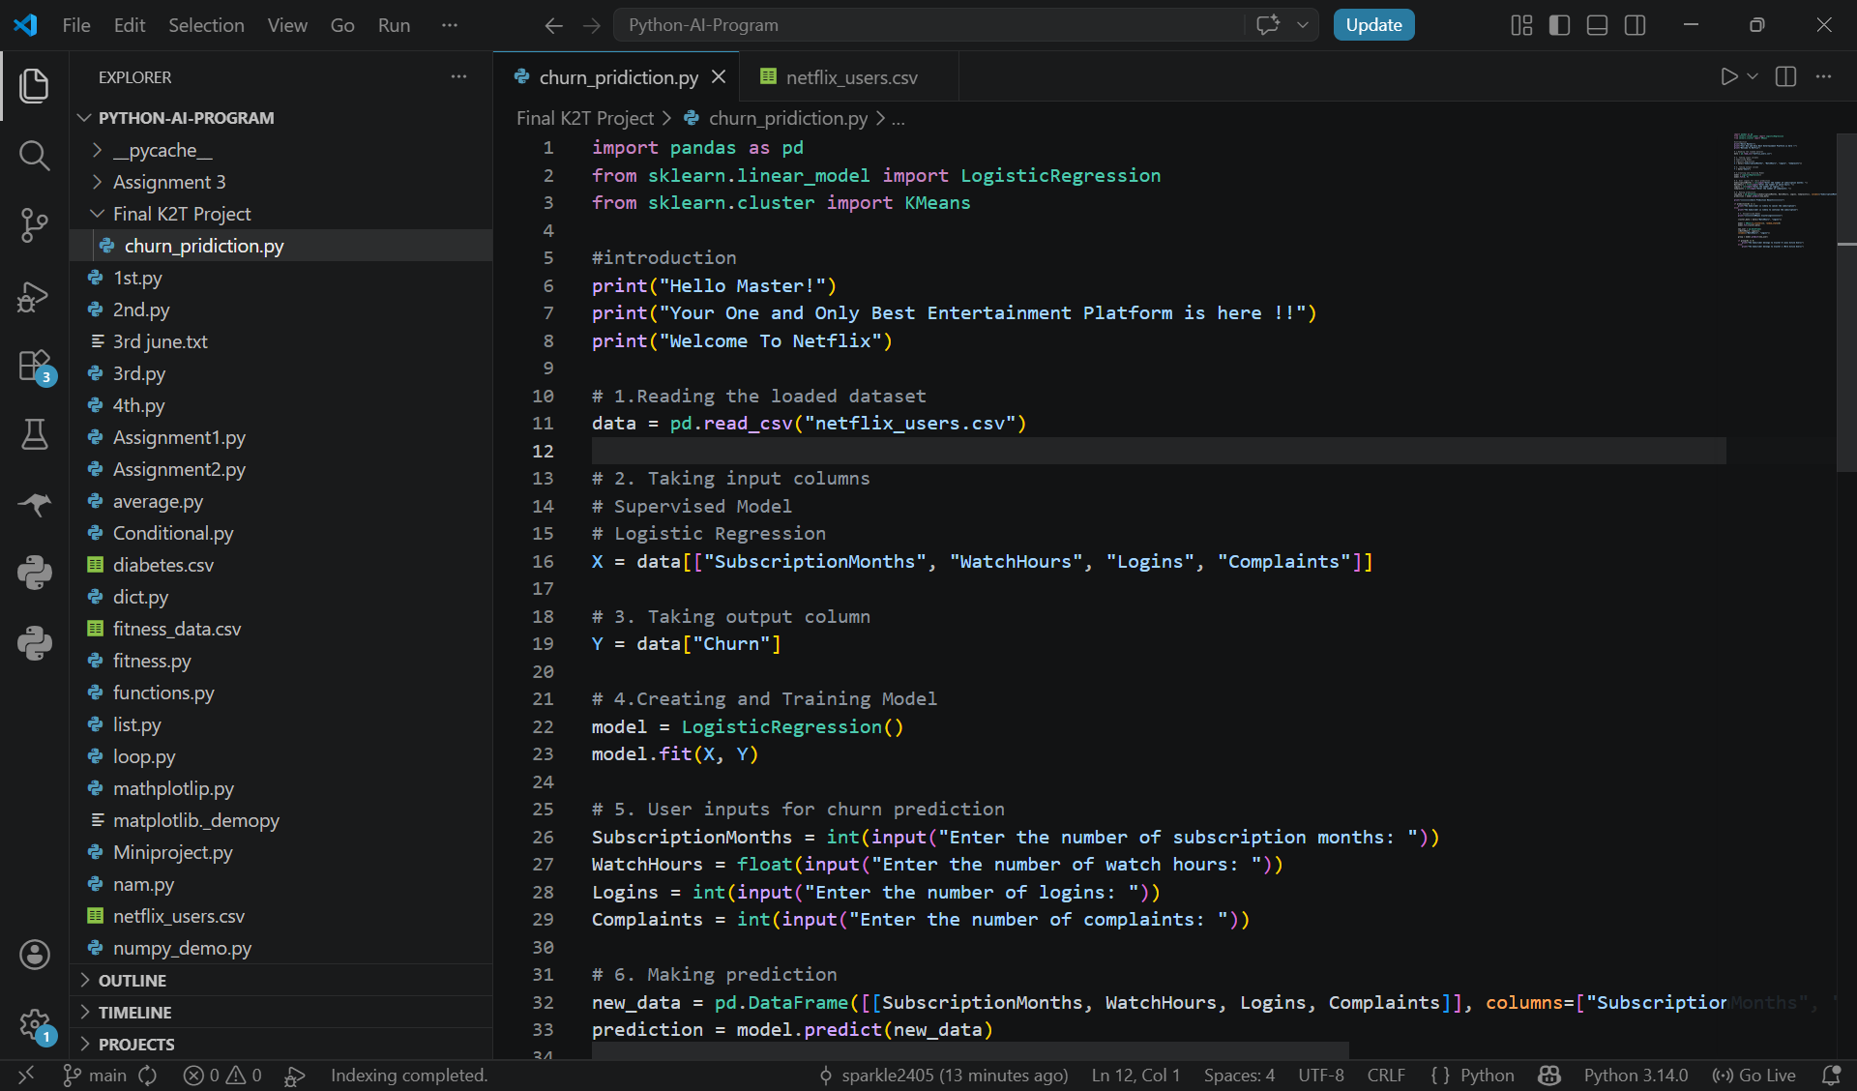
KICK TO TECH
Project Output
Project main Code
Page 8

Slide 10
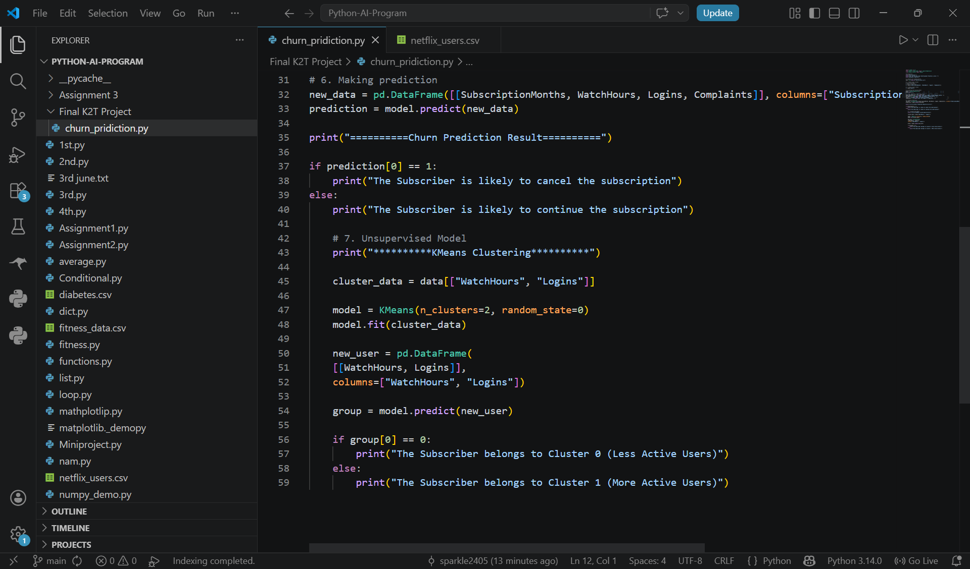
KICK TO TECH
Project Output
Project main Code
Page 8.1

Slide 11
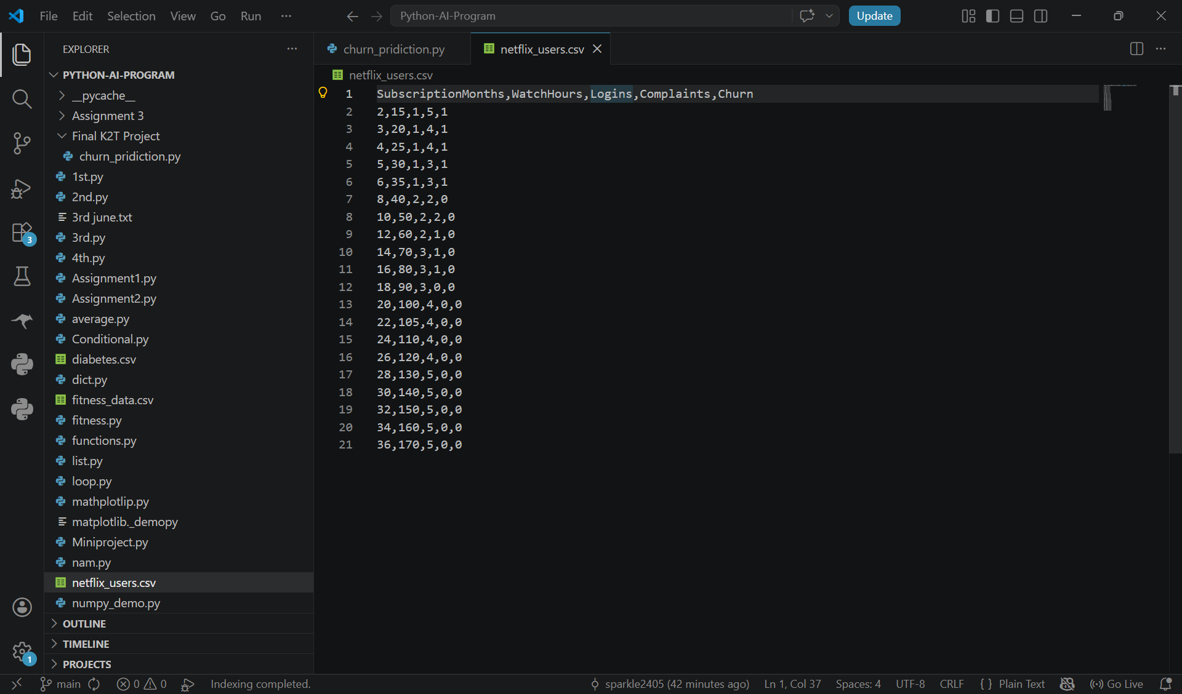
KICK TO TECH
Project Output
.csv file: it contains all the data that is used to train the model
Page 8.2

Slide 12
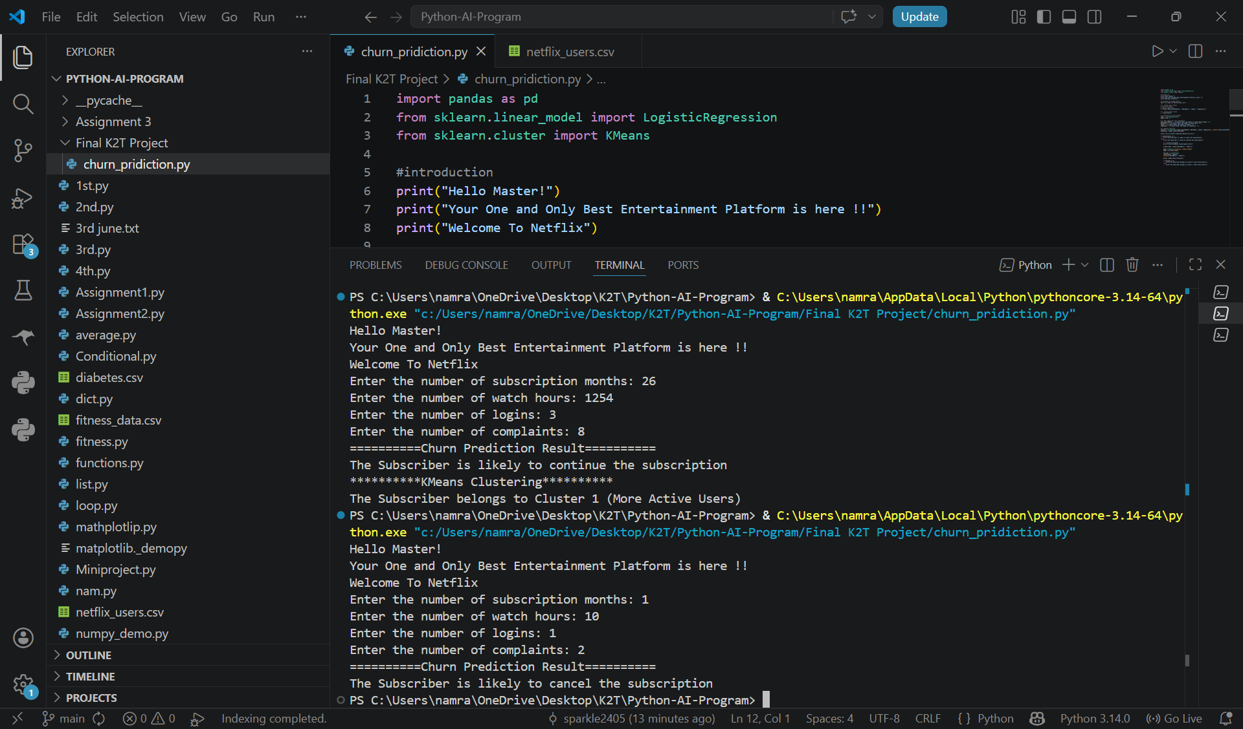
KICK TO TECH
Project Output
Output Screen
Page 8.3

Slide 13
KICK TO TECH
Findings
Subscribers with more watch hours tend to be more active.
Subscribers with fewer complaints are more likely to continue.
Machine Learning can identify possible churn risks.
K-Means successfully groups subscribers based on activity.
Conclusion
This project successfully uses:
Logistic Regression for churn prediction
K-Means Clustering for user grouping
The project demonstrates how Machine Learning can help analyze subscriber behavior and support customer retention.
Page 9

Slide 14
KICK TO TECH
Thank You
Page 10

